Slide 1
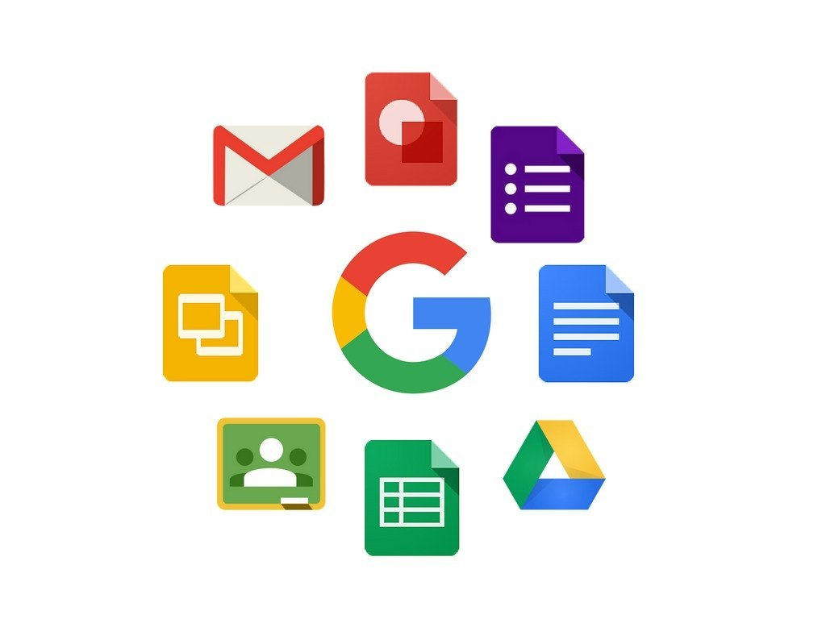
Google app

Slide 2
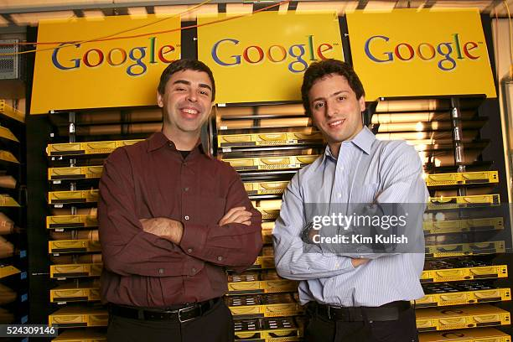
Google LLC is an American multinational technology corporation focused on information technology, online advertising, search engine technology, email, cloud computing, software, quantum computing, e-commerce, consumer electronics, and artificial intelligence.

Slide 3

Google workspace
Google Workspace includes the productivity apps you know and love—Gmail, Drive, Docs, Meet, and many more—in one location, so you can create, communicate, and collaborate.

Slide 4

How google apps are useful?
Google apps are helpful because they simplify and enhance everyday tasks by providing tools for communication, organization, information access, and collaboration.
These apps are generally free, accessible from multiple devices, and designed to work together seamlessly, boosting productivity for individuals and organizations.

Slide 5
Google apps

Slide 6
Effective delivery techniques
This is a powerful tool in public speaking. It involves varying pitch, tone, and volume to convey emotion, emphasize points, and maintain interest.
  Pitch variation
  Tone inflection
  Volume control
Effective body language enhances your message, making it more impactful and memorable.
  Meaningful eye contact
  Purposeful gestures
  Maintain good posture
  Control your expressions

Slide 7
Navigating Q&A sessions
Know your material in advance
Anticipate common questions
Rehearse your responses
Maintaining composure during the Q&A session is essential for projecting confidence and authority. Consider the following tips for staying composed:
Stay calm
Actively listen
Pause and reflect
Maintain eye contact

Slide 8
Speaking impact
Your ability to communicate effectively will leave a lasting impact on your audience
Effectively communicating involves not only delivering a message but also resonating with the experiences, values, and emotions of those listening

Slide 9

Thank you
Brita Tamm
502-555-0152
brita@firstupconsultants.com
www.firstupconsultants.com

